Slide 1

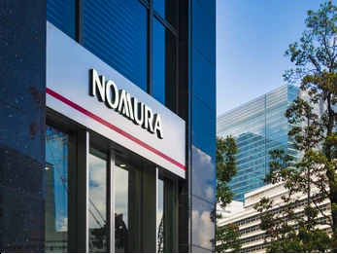


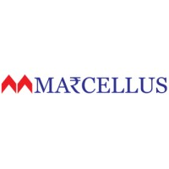



CFA Institute Research Challenge 2024-25
Strategic Valuation and Acquisition of Marcellus Investment Managers by Nomura
Team The Philosopher’s Stone
Team Members
Ayush Agarwal
Mayank Sharma
Pankaj Prithyani
Pari Goyal
Sandeepan Das

Slide 2
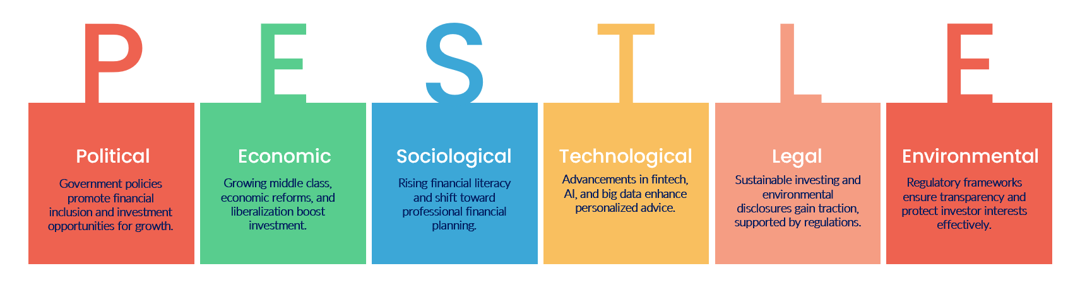
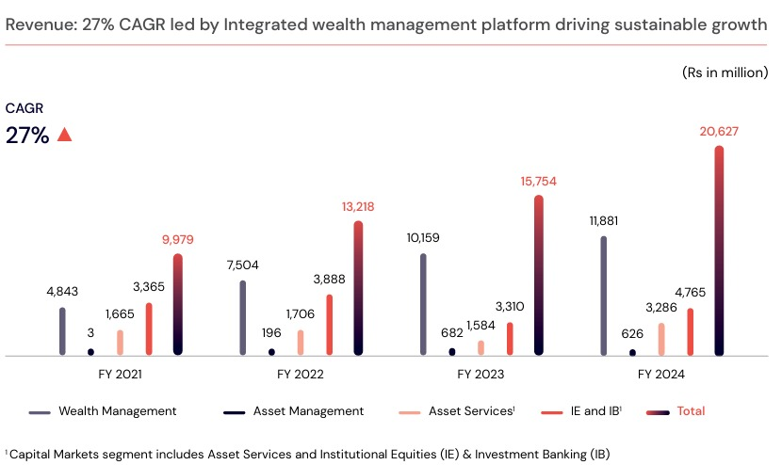
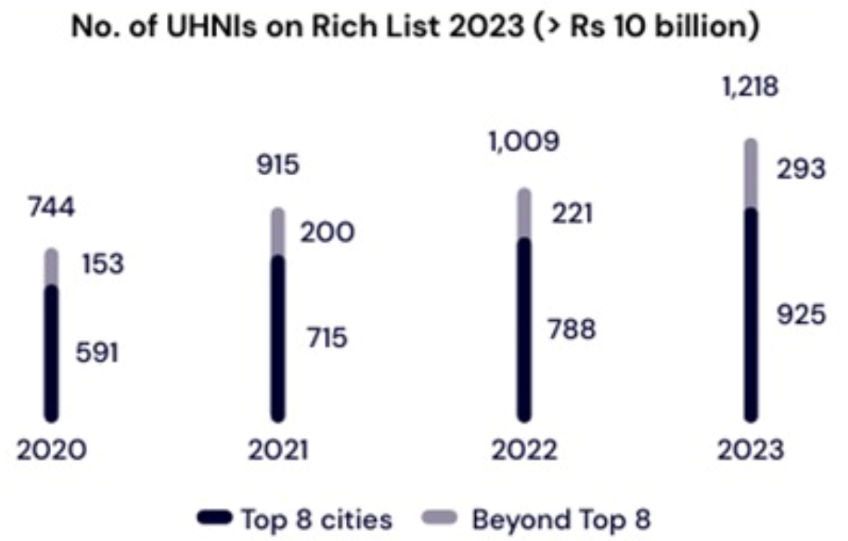

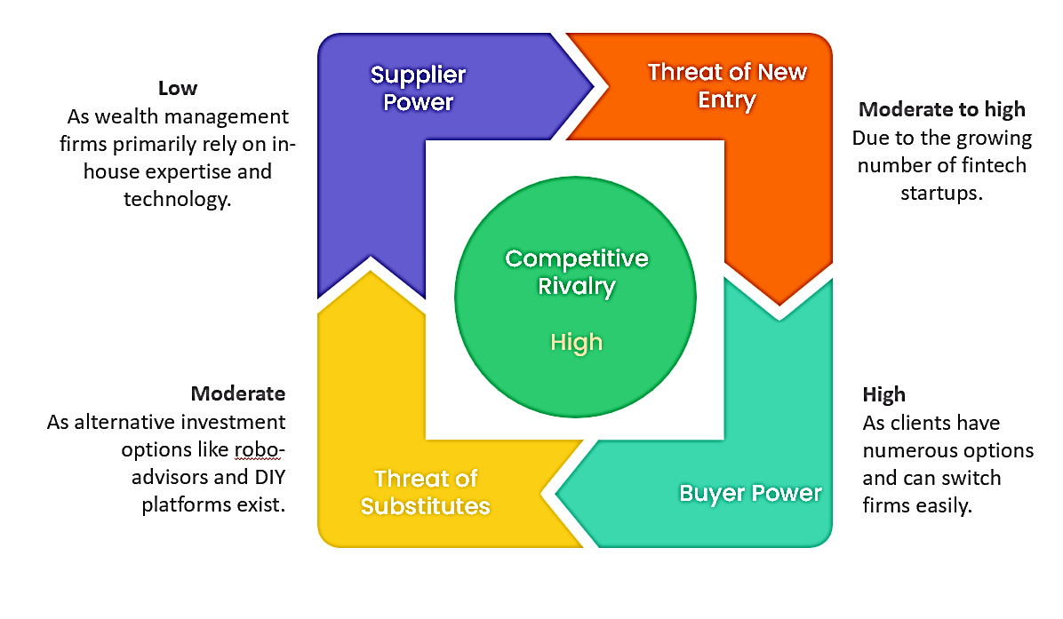
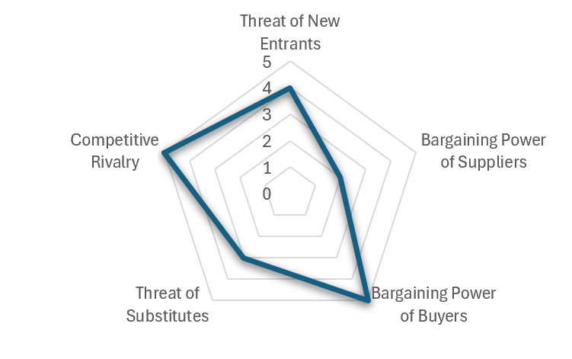
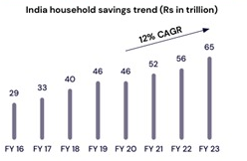





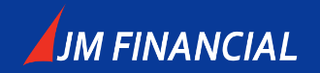
Industry Overview
1.57%
CAGR 2024-2028
(AUM growth)
42,662,898 Mn
(in INR)Size of Asset Under Management in India
5th Rank
Countries with the Ultra High Net Worth Individuals
KEY FACTS PERTAINING TO
Wealth Management
Sources: Jefferies, DRHP(Nuvama)
Revenue: 27% CAGR led by integrated wealth management platform driving sustainable growth
1
Macro-environment Outlook
2
Industry Overview
Inflation within RBI's target range
Key Growth Drivers
Current Account Deficit: Reduced from 2% of GDP in FY 2022-23 to 1% in FY 2023-24.
Increase in HNIs/UHNIs
6.1%
Rise in UHNIs (2023)
8.2% YoY in FY 2023-24, one of the highest globally.
13,263
(2023)
19,908
(2028)
Wealth growing beyond Tier 1 cities;
UHNI presence in 95 cities (up from 10 in 2012).
Number of UHNIs to grow (expected)
Shift to diversified portfolios and digital tools for wealth management.
Digital solutions, ESG focus, and competition drive current trends.
AI, digital platforms, sustainable investing, regulatory developments.
Rising income, economic growth, tech advancements, financial literacy.
Key Players
Gross household savings grew 2.8x, financial savings 3.2x, shares and debentures 13x over the last decade.
Regulatory Reforms
Efficient client money management, stronger cybersecurity, tighter insider trading regulations.
Digital Innovation
Preference shift towards non-traditional investments like MF, PMS, AIF, REITs, InvITs.
Sources: Jefferies, RBI

Slide 3
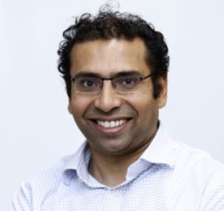
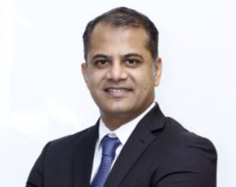
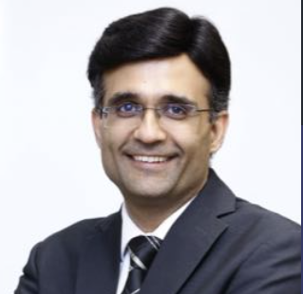




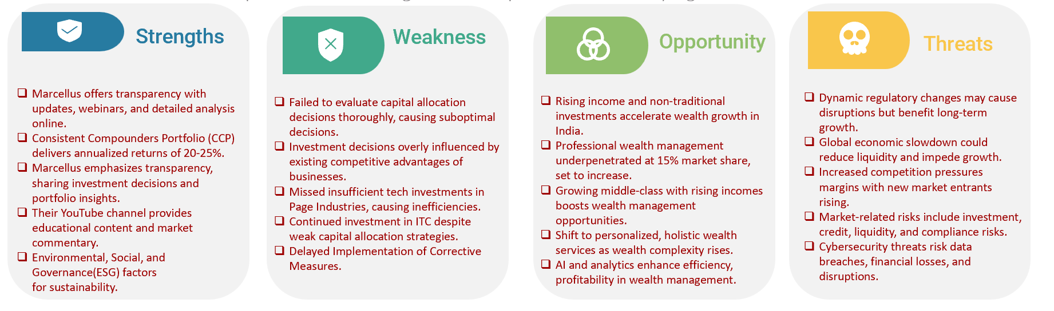





Company Overview
Managerial
Positions
Saurabh Mukherjea
CIO and Founder
Pramod Gubbi, CFA
Client Advisory & Relationship
Rakshit Ranjan , CFA
Investments
Manish Hemnani
Technology & Operations
Sapna Bhavsar
People and Culture
Nitesh Bhadani , CA
Client Advisory & Relationship
Mission & Vision
To make wealth creation simple and accessible
1
About the Company
3
1
Marcellus Investment Managers is a SEBI-registered provider of Portfolio Management Services (PMS) that offers several investment strategies focused on quality companies. Their flagship product, the Marcellus Consistent Compounders Portfolio (CCP), invests in a concentrated portfolio of heavily moated companies.
POTENTIAL
2
Product Portfolio
Consistent Compounders Portfolio
12-15 stocks, 20-30% returns, outperforms Sensex by 8-12%, includes Titan, Nestle.
Rising Giants Portfolio
Mid-cap companies, $500M-$10B, potential Nifty 50 candidates, emphasizes clean accounting.
Investment Philosophy
4
5
Little Champs Portfolio
Small-caps below $1B, seeks multi-bagger potential, focuses on long-term growth.
Sustainable Competitive Advantages
Clean Accounting
Kings of Capital Portfolio
Multi-cap financial stocks, banks, NBFCs, asset management, aims for attractive returns.
Sources: Marcellus Website, SEBI (Portfolio Manager Monthly Reports)
Marcellus’s Assets Under Management over the years
Efficient Capital Allocation
High-Quality Companies

Slide 4

Deal Overview
1
Valuation Summary
EV(EBITDA) | 328.70
SHARE PRICE AS PER P/E | 101.21
EV (AUM) | 15525.76
 | JM Financials | GEOJIT | ICICI Securities | Motilal Oswal | Average
EV/ EBITDA | 7.28 | 3.95 | 8.53 | 6.49 | 6.56
P/E | 17.41 | 10.59 | 13.86 | 10.17 | 13.01
EV/AUM | 0.3 | 0.01 | 0.38 | 0.06 | 0.19
EBITDA | 50.09
EPS | 7.781
AUM | 82864.80
Intrinsic Valuation(Discounted Cash Flow)
Present Value as per DCF
1881
(in INR mn)
Intrinsic Value /share
370.93
(in INR )
2
Key Risks of the Business
3
Potential Synergies
4
Additional Considerations
Market risk
PMS exposed to fluctuations, economic conditions, global events.
Revenue Growth
Cross-selling opportunities for both firms lead to increased assets under management and higher fee income
Cost Savings
Operational efficiencies achieved through shared resources and technology platforms
Enhanced Brand
Combined brand equity attracts a wider range of clients and top talent
Innovation
Joint development of new investment products and services catering to evolving client needs
Integration Plan
Detailed roadmap outlining smooth integration of operations, technology, and personnel.
Regulatory Approvals
Proactive engagement with relevant authorities to ensure timely clearance.
Valuation
Rigorous assessment considering market comparable, growth potential, and synergies.
Risk of underperformance
No guaranteed PMS will outperform benchmarks consistently.
Fee structure
High fees can significantly erode returns generated by PMS.
Lack of liquidity
Illiquid assets may delay selling or cause suboptimal pricing.
5
Recommendation
Concentration risk
Concentrated positions in stocks/sectors heighten potential downturn impact.
The acquisition of Marcellus by Nomura represents a compelling strategic move with significant potential for value creation. A thorough due diligence process and a well-articulated integration plan are crucial for realizing the full benefits of this synergistic combination.
Shifts in regulations can impact PMS operations and strategies.

Slide 5
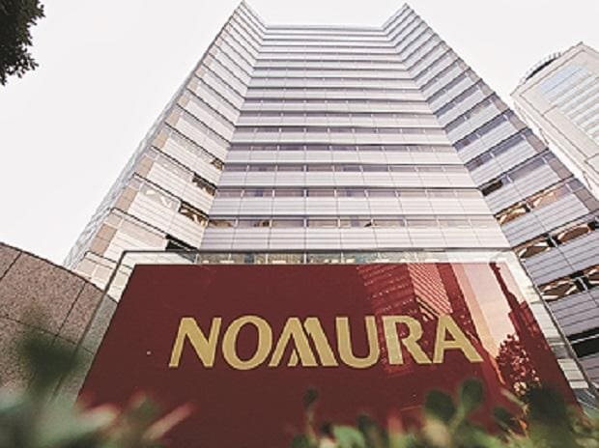
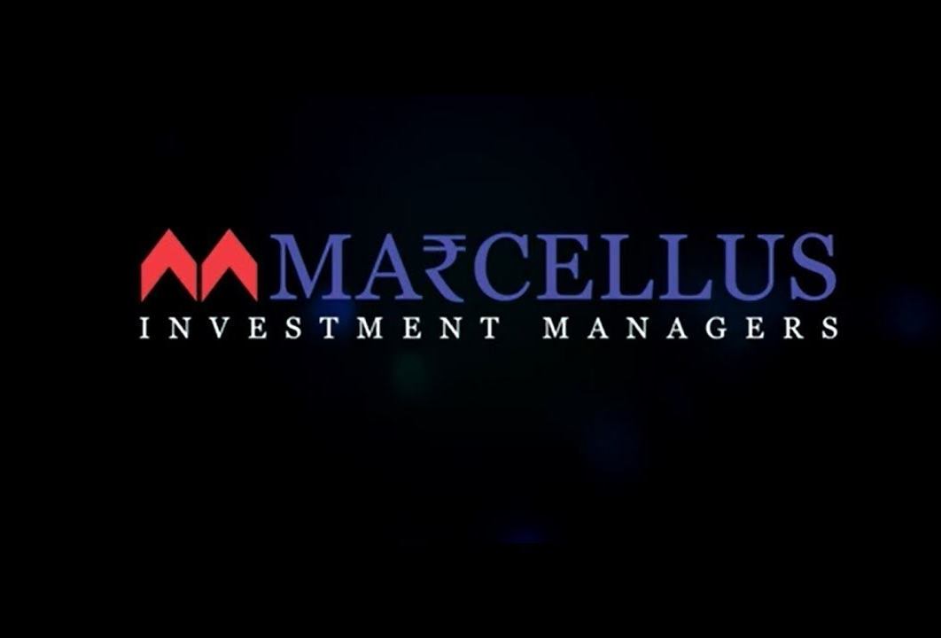
THANK YOU

